Slide 1
FIFA WORLD CUP
Analysis By: Arti Yadav
www.linkedin.com/in/arti-yadav-428b11229
https://drive.google.com/file/d/1gVYRxEFFhIBfih1kaBj4BmGK-dtSBYAC/view?usp=drive_link

Slide 2
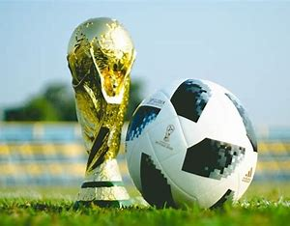
INTRODUCTION
With FIFA is in the blood of many people of the world. The FIFA World Cup is a global football competition contested by the various football-playing nations of the world. It is contested every four years and is the most prestigious and important trophy in the sport of football.

Slide 3

Purpose
In this project we are going to analyse key metrics and factors that influence the World Cup win.

Slide 4
Dataset Description
we are having three different datasets:
World Cup Matches : World Cup Matches dataset shows all the results from the matches contested as part of the cups.
World Cup :The World Cups dataset shows all information about all the World Cups in history.
World Cup Players : The World Cup Players dataset shows all information about all the players and Coaches.

Slide 5
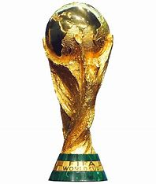
Project Structure
Statistical Summary
Data Cleaning
Data Modification
Data Preprocessing
Exploratory Data Analysis (EDA
Data Visualization
Conclusion Of Analysis

Slide 6
Summary of the Project
The three dataset is used for this project.
The World Cup Matches dataset contains 4572 observations with 20 features.
The World Cup Players dataset contains 37784 observations with 9 features.
The World Cup Players dataset contains 20 observations with 10 features.
The goal of the project is to find key metrics and factors that influence the World Cup win.
The project will involve Data Cleaning , Data Pre-processing , Exploratory data analysis, and Visualization.

Slide 7
Pre-processing
Data Cleaning:
some column name has an excess of �' symbols, so this symbol needs to be removed for the appropriate column name.
We have equal no. of null values in each columns(blank rows) of Match Dataset so we should drop that rows.
In World Cup data set, we can see 'Position' & 'Event' has maximum no. of null values. but most of the data are duplicates.so instead of dropping columns we will drop null values.
Also we need to drop the duplicates of each datasets.
Descriptive Statistics:
EDA uses statistical measures (e.g., mean, median, standard deviation, range) to understand variable tendencies, variability, and distributions.
Data Visualization:
Visual techniques (Barplot, countplot , pie plots,boxplot etc.) represent data graphically.
These visualizations help identify trends, patterns, and relationships.

Slide 8
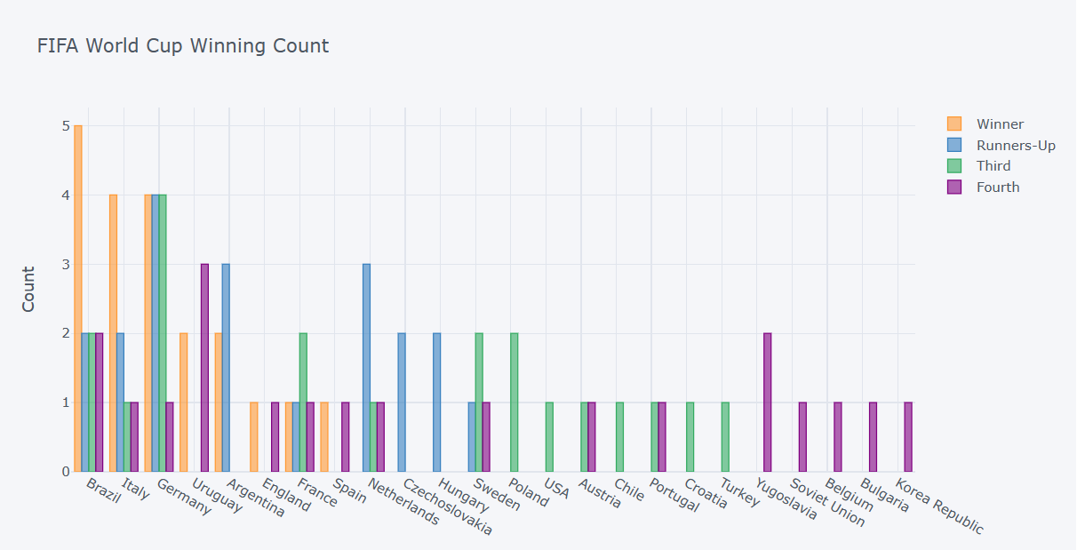
World Cup Winning count
From Above plots we can conclude that:
Brazil has won most no. of titals .
Brazil has also played more finals & semifinals.
Followed by Brazil, Germany has played & won most no. of titals.
By seeing the above plot we can say that Brazil,Germany & Italy are the most succesful teams in tournament.

Slide 9
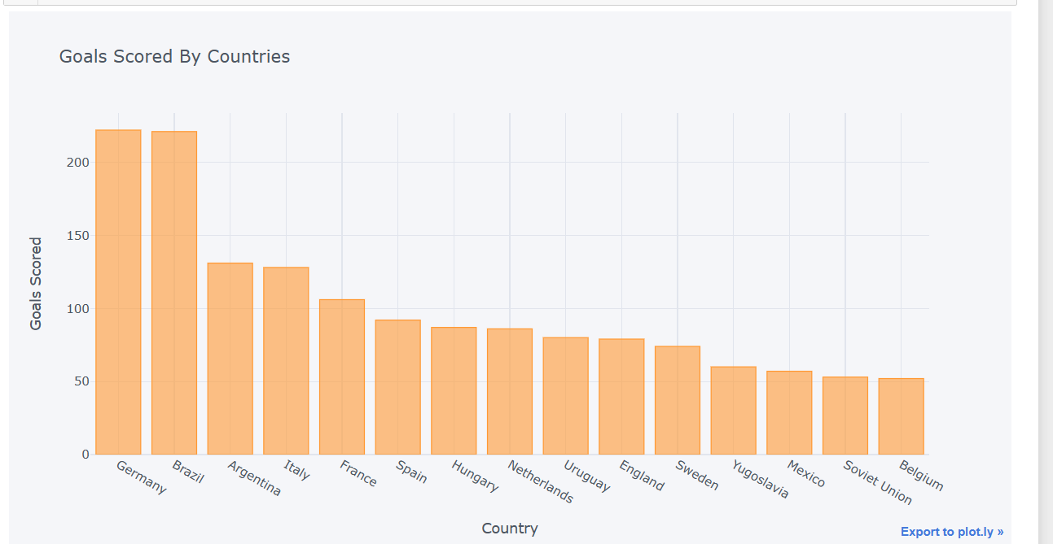
Goals Scored By Countries
Germany has scored most no. of Goals. [Total=222 Goals]
Followed by Germany , Brazil has scored most no. Goals. [Total=221]
While Argentina has scored 131 Goals & Italy has scored 128 Goals so far in this tournament.

Slide 10
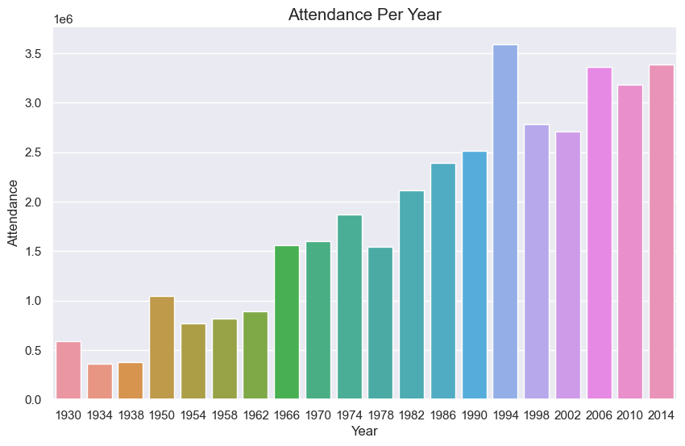
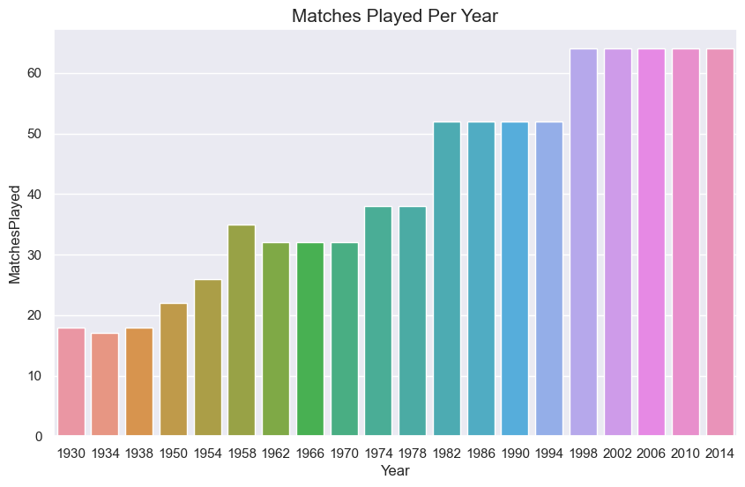
Attendance can be boosting factor in winning ,as audience cheers & boost the confidence of players.
As we can see audience counts are increasing by year.
we can say that tournament has becaming more popular
As we can see Matches counts are increasing by year.
As tournament has becaming more popular qualification gets more tougher.

Slide 11
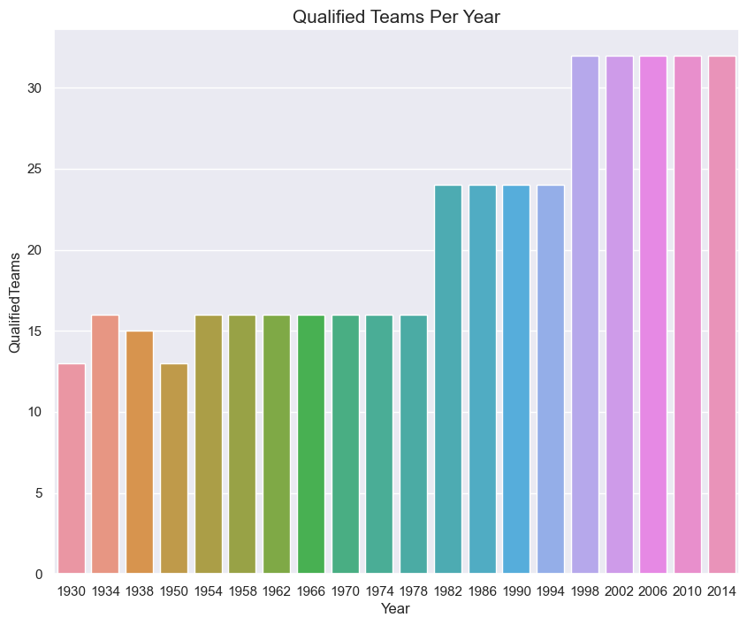
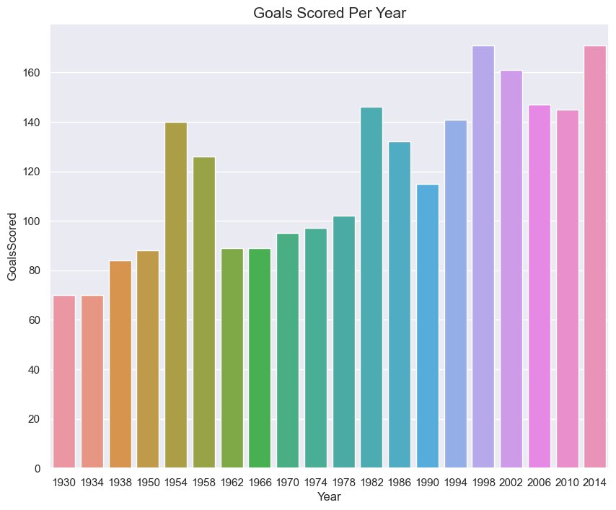
The counts of qualified teams are increasing by year.
As tournament has becoming more popular participation & qualification has increase.
In year 1998 & 2014 we have seen most no. of Goals Scored.

Slide 12
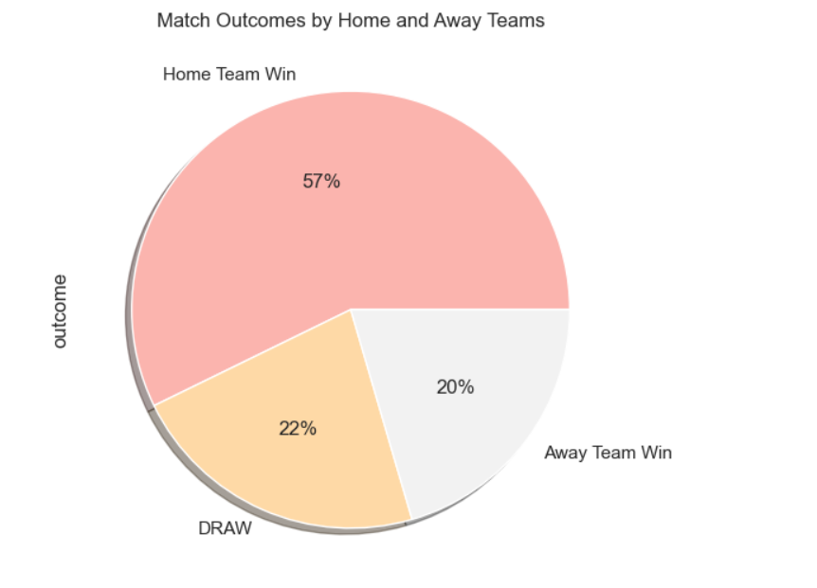
Outcomes of match by home team & away team
By above plot we can say that:
Match Outcomes by 'Home Team' as winning is more.[57%]
Match Outcomes by 'Away Team' as winning is less than 'Home team'.[20%]
22% outcomes of the matches are Draw.

Slide 13
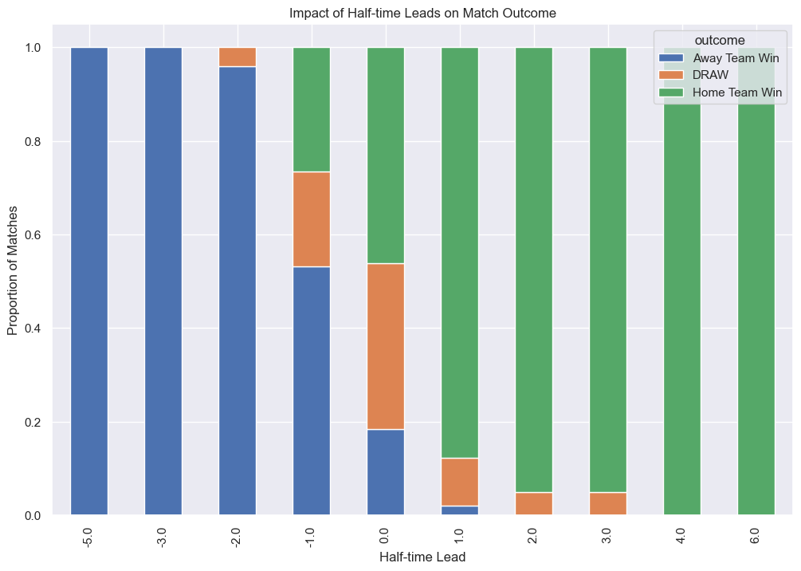
Impact of half time
Half-time Leads on Match Outcomes impacting more 'Home Team Win' rather than 'Away Team Win'.

Slide 14
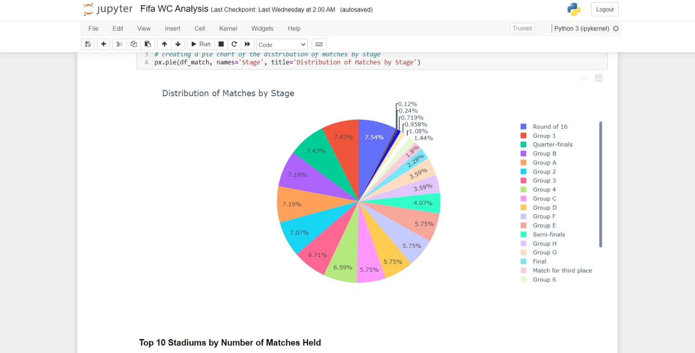
Distribution of match stages

Slide 15
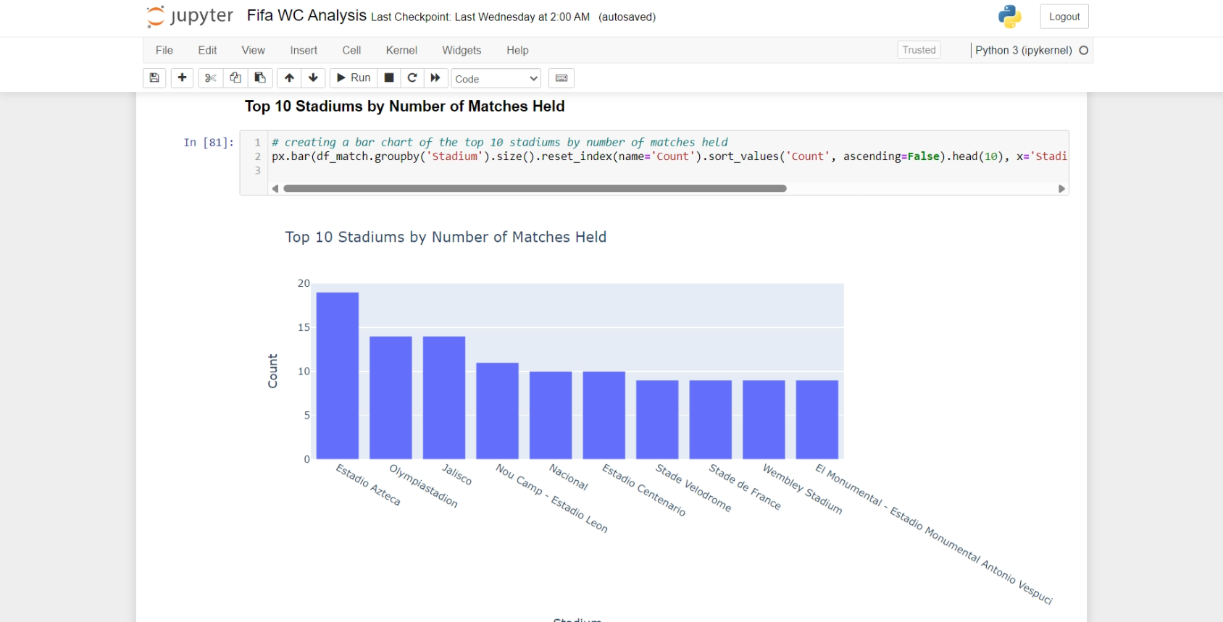
TOP 10 Stadiums By number of matches held

Slide 16
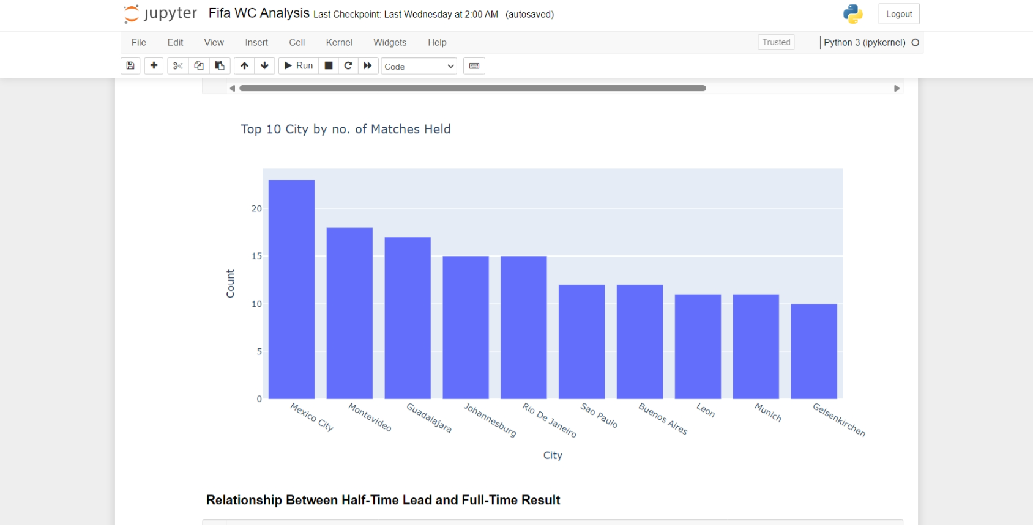
TOP 10 City By number of matches held
Mexico City
Montevideo
Gudalajara
Johannesburg
Rio De Janeirio
Sao Paulo
Leon
Munich
Gelsenkirchan

Slide 17
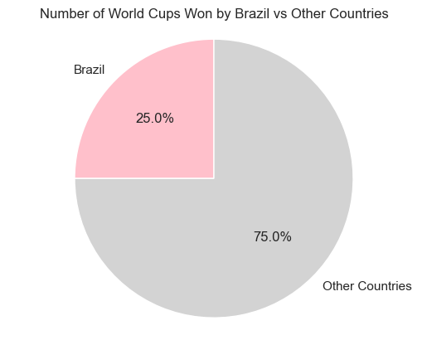
most 'Successful Team' in the tournament
We can observe that brazil alone has most no. of winning percent of 25% .
Other countries than Brazil combined has 75% of winning percent.
We can conclude that Brazil is most 'Successful Team' in the tournament.

Slide 18
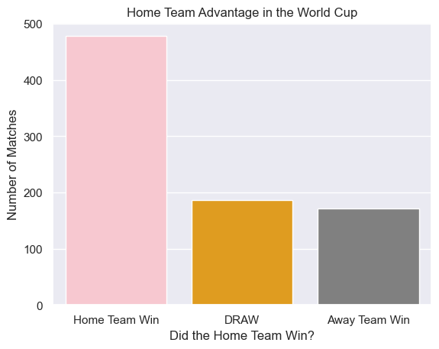
Did Home Team has more advantage ???
We can observe that Home Team Win is more than 400 times .
We can observe that Away Team Win around 200 times.
Also rest outcomes are Draw.
We can conclude that Home Team has more advantage od winning tournament.

Slide 19
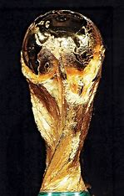
CONCLusion
Based on analysis of the Fifa Wc dataset, we can draw the following conclusions:
By seeing the analysis we can say that Brazil , Germany & Italy are the most successful teams in tournament.
Brazil has won most no. of titles.
Germany & Italy has almost equal no. of titles.
We can conclude that Brazil is most 'Successful Team' in the tournament.
Attendance can be boosting factor in winning ,as audience cheers & boost the confidence of players.
Match Outcomes by 'Home Team' as winning is more.[57%]
We can conclude that Home Team has more advantage od winning tournament.

Slide 20
THANK YOU…..

